Slide 1
CLI AUTOMATION

Slide 2

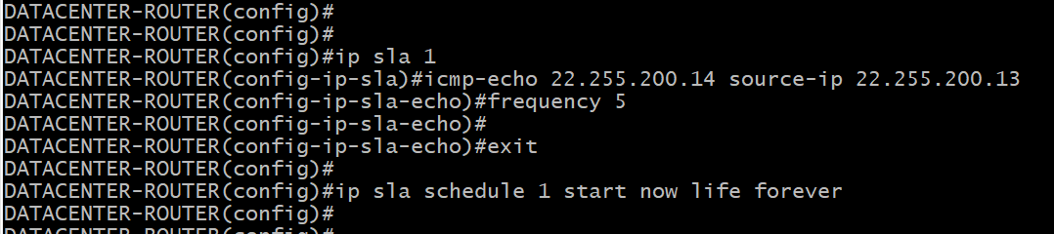
22.255.200.13
22.255.200.14
Ip sla 1
Icmp-echo x.x.x.x source-ip x.x.x.x
Frequency x
Ip sla schedule 1 start now life forever

Slide 3
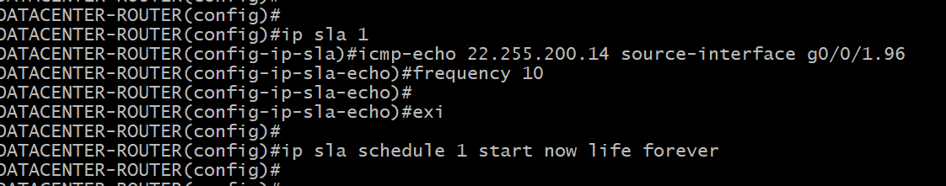
G0/0/1.96
22.255.200.14
Ip sla 1
Icmp-echo x.x.x.x source-interface xxx
Frequency x
Ip sla schedule 1 start now life forever

Slide 4
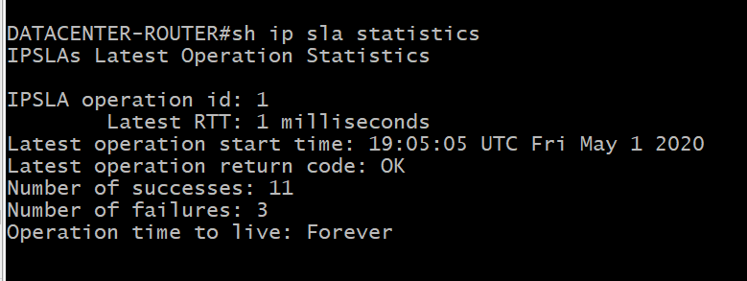
22.255.200.13
22.255.200.14
Show ip sla statistics

Slide 5
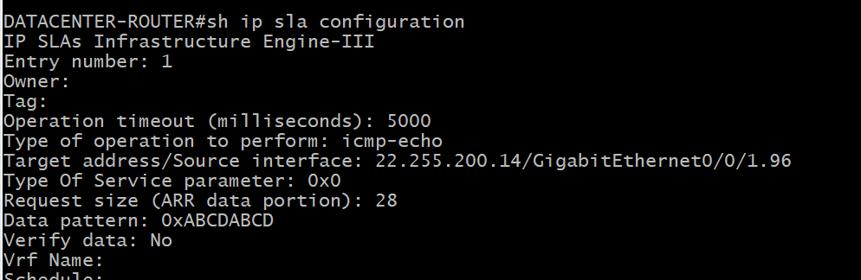
22.255.200.13
22.255.200.14
Show ip sla configuration

Slide 6
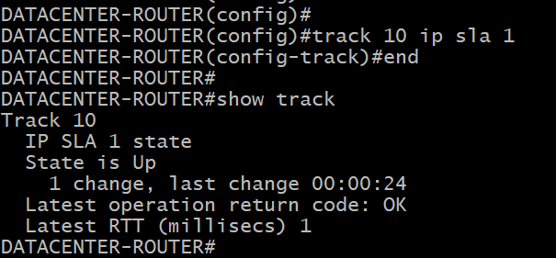
INT LO 100
192.168.100.1
G0/1 – 10.0.0.1
Track 10 ip sla 1
Show track

Slide 7
INT LO 100
192.168.100.1
G0/1 – 10.0.0.1
INT LO 200
192.168.200.1
Ip sla 1
Icmp-echo 192.168.100.1 source-ip 10.0.0.1
Frequency 5
Ip sla 2
Icmp-echo 192.168.200.1 source-interface g0/1
Frequncy 10
Ip sla schedule 1 start now lifetime forever
Ip sla schedule 2 start now lifetime forever

Slide 8
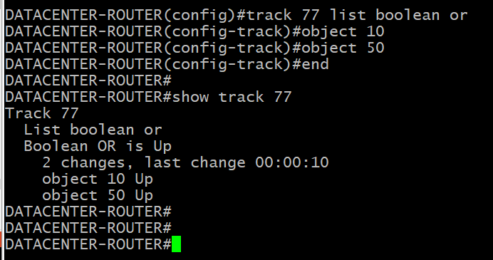
INT LO 100
192.168.100.1
G0/1 – 10.0.0.1
INT LO 200
192.168.200.1
Track 10 ip sla 1
Track 50 ip sla 2
Track 77 list Boolean or
Object 10
Object 50
Track 78 list Boolean and
Object 10 not
Object 50
Track 79 list Boolean or
Object 10 not
Object 50 not

Slide 9
INT LO 100
192.168.100.1
G0/1 – 10.0.0.1
G0/0 – 1.1.1.1
ARTILLERY LAN
INT LO 200
192.168.200.1
Track 10 ip sla 1
Track 50 ip sla 2
Track 77 list Boolean or
Object 10
Object 50
Track 78 list Boolean and
Object 10 not
Object 50
Track 79 list Boolean or
Object 10 not
Object 50 not
Event manager applet WOBC-RC
Event track 10 state down
Action 1.0 cli command “enable”
Action 2.0 cli command “config t”
Action 3.0 cli command “interface g0/0”
Action 4.0 cli command “shutdown”
Action 5.0 syslog msg ARTILLERY_LAN_DOWN
Event manager applet WOBC-RC_1
Event track 10 state up
Action 1.0 cli command “enable”
Action 2.0 cli command “config t”
Action 3.0 cli command “interface g0/0”
Action 4.0 cli command “no shutdown”
Action 5.0 syslog msg ARTILLERY_LAN_OPERATIONAL

Slide 10

WHAT IS HAPPENING IN THE BACKGROUND?
STEP 1. THE IP SLAs THAT ARE BEING MONITORED BY TRACK 77 STOP RETURNING A CODE OF “OK”
STEP 2. THE STATE OF TRACK 77 GOES FROM UP TO DOWN
STEP 3. THE EVENT MANAGER EXECUTES THE SERIES OF “ACTION” COMMANDS IN NUMERICAL ORDER

Slide 11
INT LO 100
192.168.100.1
G0/1 – 10.0.0.1
G0/0 – 1.1.1.1
ARTILLERY LAN
INT LO 200
192.168.200.1
Track 10 ip sla 1
Track 50 ip sla 2
Track 77 list Boolean or
Object 10
Object 50
Track 78 list Boolean and
Object 10 not
Object 50
Track 79 list Boolean or
Object 10 not
Object 50 not
Event manager applet EIGRP-BUILDER
Event track 78 state up
Action 1.0 cli command “enable”
Action 2.0 cli command “config t”
Action 3.0 cli command “router eigrp TESTING”
Action 4.0 cli command “address-fam ipv4 uni auton 1”
Action 5.0 cli command “network 10.0.0.0 0.0.0.3”
Action 6.0 cli command “network 1.1.1.0 0.0.0.255”
Action 7.0 cli command “topology base”
Action 8.0 cli command “distribute-list 10 in g0/1”
Action 9.0 syslog msg EIGRP-IS-IN-EFFECT
Event manager applet EIGRP-REMOVAL
Event track 78 state down
Action 1.0 cli command “enable”
Action 2.0 cli command “config t”
Action 3.0 cli command “no router eigrp TESTING”

Slide 12
INT LO 100
192.168.100.1
G0/0 – 1.1.1.1
ARTILLERY LAN
G0/1 – 10.0.0.1
INT LO 200
192.168.200.1
G0/2 – 2.2.2.1/24
Track 10 ip sla 1
Track 50 ip sla 2
Track 77 list Boolean or
Object 10
Object 50
Track 78 list Boolean and
Object 10 not
Object 50
Track 79 list Boolean or
Object 10 not
Object 50 not
Event manager applet EIGRP-BUILDER
Event track 78 state up
Action 1.0 cli command “enable”
Action 2.0 cli command “config t”
Action 3.0 cli command “router eigrp TESTING”
Action 4.0 cli command “address-fam ipv4 uni auton 1”
Action 5.0 cli command “network 10.0.0.0 0.0.0.3”
Action 6.0 cli command “network 1.1.1.0 0.0.0.255”
Action 7.0 cli command “topology base”
Action 8.0 cli command “distribute-list 10 in g0/1”
Action 9.0 syslog msg EIGRP-IS-IN-EFFECT
Event manager applet EIGRP-BUILDER
Action 6.5 cli command “network 2.2.2.0 0.0.0.255”

Slide 13
R1#
Config t
Alias exec x1 show ip int brief
Alias exec x2 show ip route
Alias exec x3 show ip ospf neighbor
Alias exec b1 show bgp vpnv6 vrf BGP-NEIGHBORS unicast summary | incl 22.228.0.1
Alias configure e9 router eigrp 9
Alias configure t9 interface tunnel 97009
Alias configure a1 ip access-list extended INBOUND-TRAFFIC
Alias exec RESET tclsh reset.base-config.tbc

Slide 14
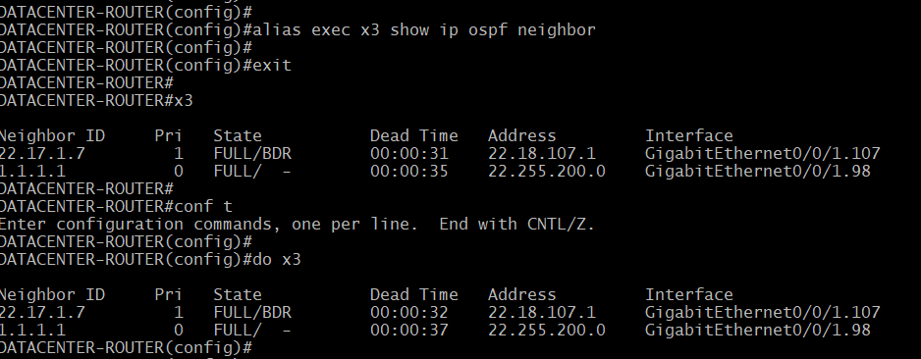
R1#
Config t
Alias exec x3 show ip ospf neighbor

Slide 15
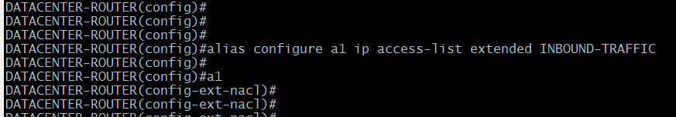
R1#
Config t
Alias configure a1 ip access-list extended INBOUND-TRAFFIC

